Slide 1

E-COMMERCE WEBSITE LIFESTYLE STORE
DETAILED DEVELOPER REPORT

Slide 2
SECURITY STATUS – EXTREMELY VULNERABLE
Hackers can steal all the records of LIFESTYLE STORE database (SQLi).
Hacker can take control of complete server including View, Add, Edit, Delete files and folders (Shell Upload).
Hacker can change source code of application to host malware, phishing pages or even explicit content (Shell Upload).
Hackers can see detail of any customer.
Hacker can easily bypass Admin account authentication (bruteforcing).
Hackers can access the seller details and login into the website using customer of the month usernames (PII).
Hacker can change the password , confirm order and remove items of customers (CSRF).

Slide 3
Vulnerability Statistics
Critical
10
Severe
6
Moderate
10
Low
6

Slide 4
Vulnerabilities:
S.NO. | SEVERITY | VULNERABILITY | COUNT
1 | CRITICAL | SQL injection | 3
2 | CRITICAL | Access to admin panel | 1
3 | CRITICAL | Arbitrary file upload | 2
4 | CRITICAL | Account takeover by OTP bypass | 1
5 | CRITICAL | CSRF | 3
6 | SEVERE | Reflected cross site scripting | 1
7 | SEVERE | Stored cross site scripting | 1
8 | SEVERE | Common password | 1
9 | SEVERE | Component with known vulnerability | 3
10 | MODERATE | Server misconfiguration | 1
11 | MODERATE | Unauthorized access to user details (IDOR) | 4
12 | MODERATE | Directory listings | 5
13 | LOW | Personal Information leakage | 2
14 | LOW | Client side and server side validation bypass | 1
15 | LOW | Default error display | 1
16 | LOW | Open redirection | 2

Slide 5
1. SQL Injection
SQL INJECTION (CRITICAL) | Below mentioned URL in the Hogwarts House Details module is vulnerable to SQL injection attack URL - http://15.206.27.254/products.php?cat=1 Affected Parameters : Category (GET parameter) Payload: Cat=1’

Slide 6
SQL INJECTION (CRITICAL) | Here are other similar SQLi in the application Affected URL : http://15.206.27.254/products.php?cat=2 (Category GET parameter) http://15.206.27.254/products.php?cat=3 (Category GET parameter)

Slide 7
Observation
Navigate to the Main page of the website where you will see category option , click on “T-Shirts” or “Socks” or “Shoes” to get into this URL.
Notice the get parameter in the url ; apply a single quote after the parameter and it will throw a MySQL error.

Slide 8
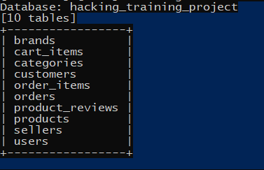
Proof of Concept (POC)
Attackers can use sqlmap to extract critical information from the website .
Number of Databases : 2
Information Schema
hacking_training_project
Number of tables in hacking_training_project : 10
brands
cart_items
categories
customers
order_items
orders
product_reviews
products
sellers
users

Slide 9
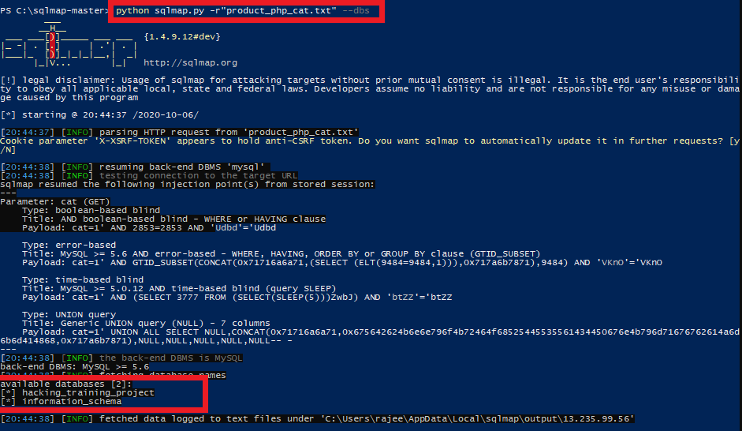

Slide 10
Business Impact – Extremely High
Using this vulnerability, attacker can execute arbitrary SQL commands on Lifestyle store server and gain complete access to internal databases along with all customer data inside it.
He can also use sqlmap to extract data.

Slide 11
Recommendations :
Prepared Statements: Use SQL prepared statements available in all web development languages and frameworks to avoid attacker being able to modify SQL query
Do not run Database Service as admin/root user
Disable/remove default accounts, passwords and databases
Assign each Database user only the required permissions and not all permissions
Character encoding: If you are taking input that requires you to accept special characters, encode it. Example. Convert all ‘ to \’ , “ to \”, \ to \\. It is also suggested to follow a standard encoding for all special characters such has HTML encoding, URL encoding etc

Slide 12
References
https://www.owasp.org/index.php/SQL_Injection
https://en.wikipedia.org/wiki/SQL_injection

Slide 13
2. Admin account takeover (OTP Bruteforce)
Admin account takeover (OTP Bruteforce) (CRITICAL) | The below mentioned login page allows login through OTP brute forcing : Affected URL - http://15.206.117.94/reset_password/admin.php Affected Parameter – OTP (Post)

Slide 14
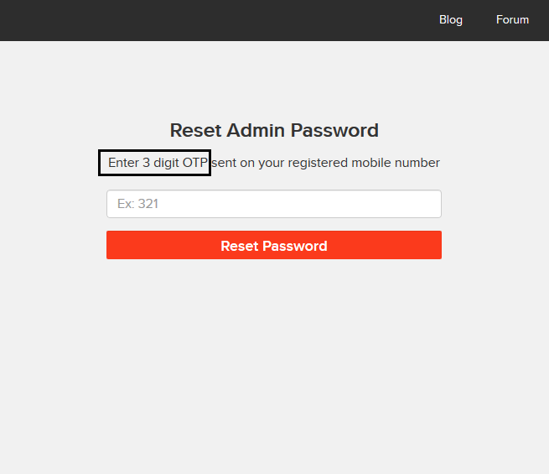
Observations
Navigate to http://15.206.117.94/login/admin.php ; you will see a forgot password link. Clicking on it will take you to a web page which will ask you for an OTP which is sent to the admin’s phone number.
Write any 3 digit number and send it . Then intercept the request with burp suite.
Send the request to intruder.

Slide 15
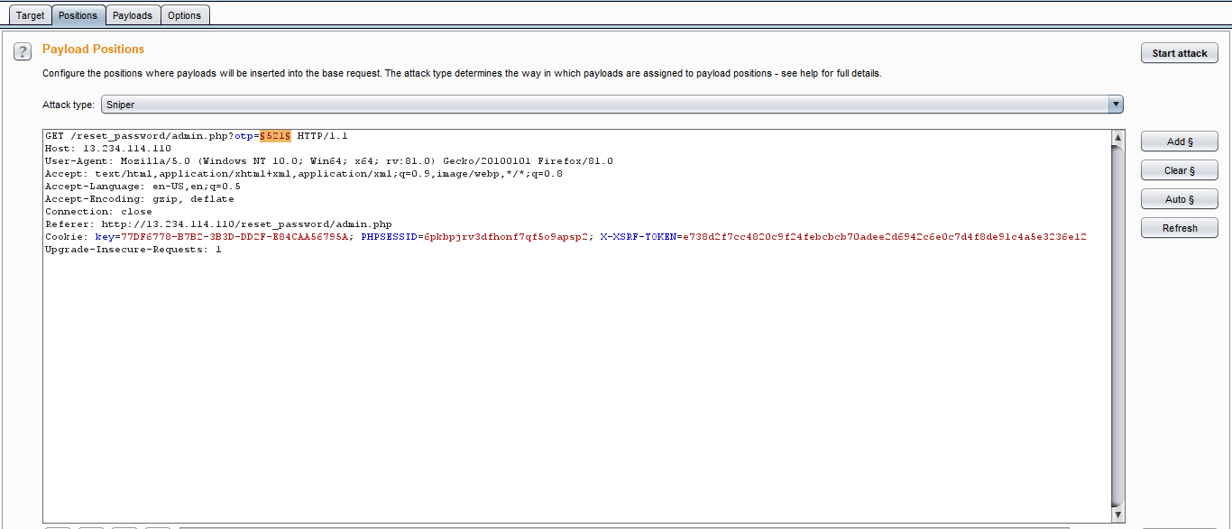
Observation :
Following request will arrive in the intruder panel.

Slide 16
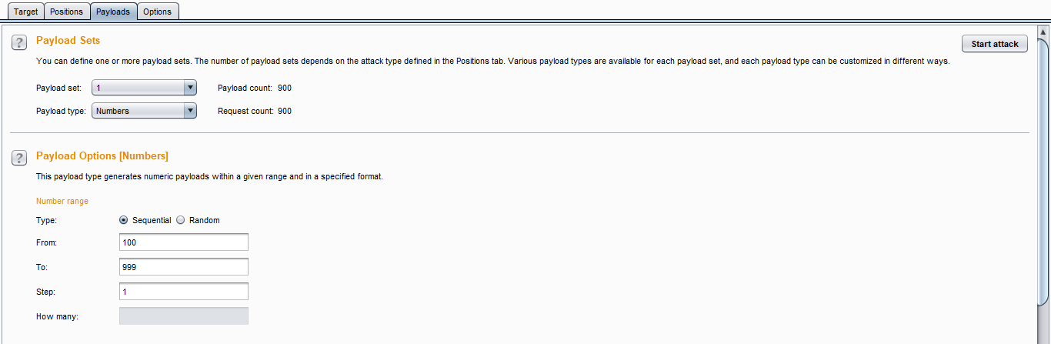
Observations:
The following payloads were used to scan all possible 3 digits numbers for the OTP.

Slide 17
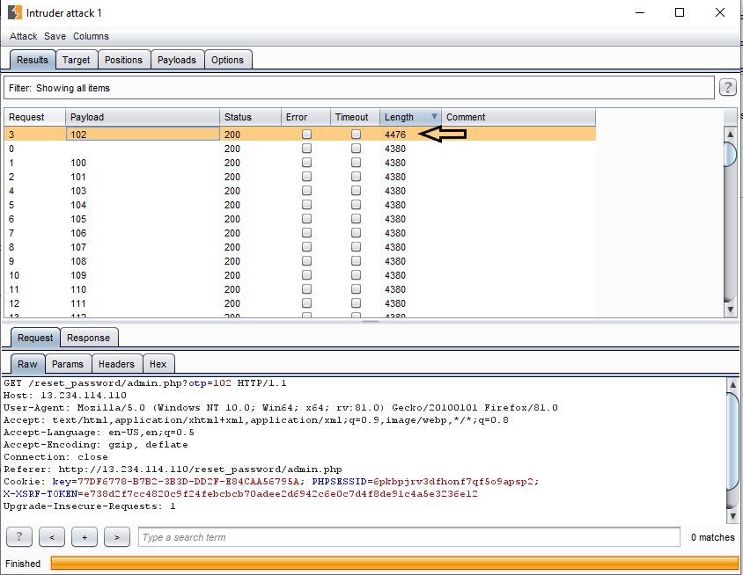
Observations: OTP found

Slide 18
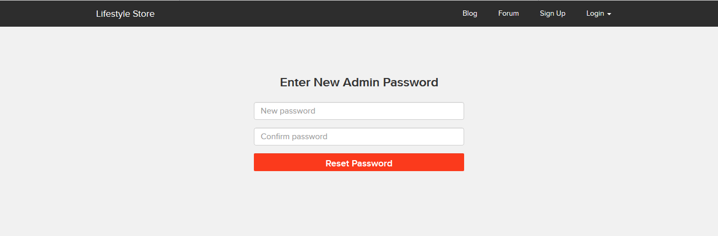
POC
OTP have been accepted. Now we will be able to change Admin Password.

Slide 19
Business Impact – Extremely High
A malicious hacker can get access to admin account just by brute forcing due to rate limiting flaw which allows a hacker to attempt entering the OTP as many times as he wants as there are no bounds in number of attempts.
This can lead to complete compromise of personal user data of every customer.
Once the attacker have logged in ; he can cause heavy financial loss to the company.

Slide 20
Recommendation
Use rate limiting checks on the number of times the otp request have been granted.
OTP should be at least 6 digits long.
OTP should expire in a particular time (ex – 2 min). This can make the authorization more secure.

Slide 21
3. XSS, execute console commands and shell upload on Admin Dashboard
XSS , execute console commands and shell upload on Admin Dashboard (CRITICAL) | The Admin dashboard allows hackers to upload shells , execute shell commands and permanent XSS. Affected URL - http://3.6.93.248/admin31/dashboard.php Affected parameter – Image Affected parameter – console

Slide 22
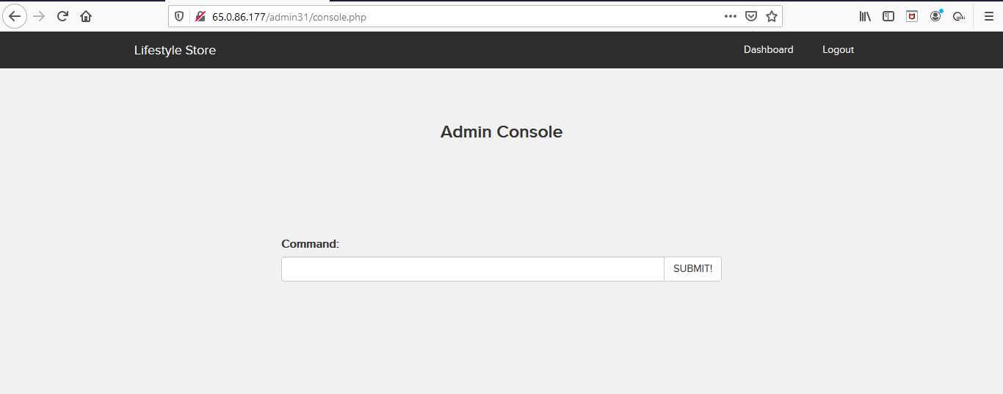
Observation
When you log into as Admin you will be redirected to a page called admin dashboard. On the top left corner you will see a button called console. If you click on it ; it will redirect you to page where you will be able to execute console commands. An attacker can you it to gain information about the server.

Slide 23
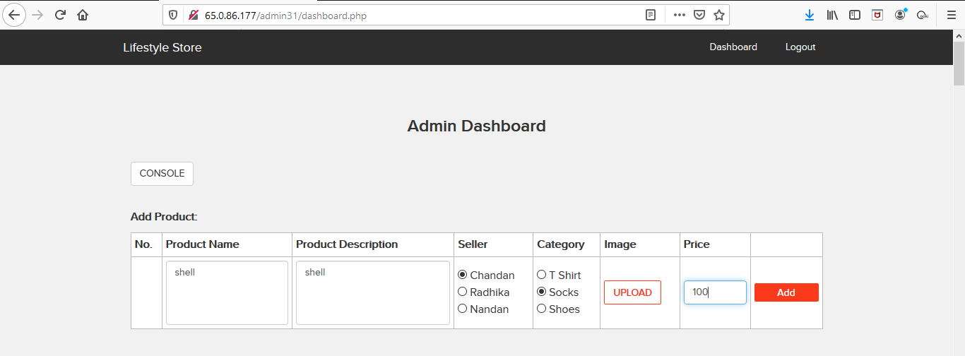
Observations
When you log into as Admin you will be redirected to a page called admin dashboard. Here admin uploads new products which are to be sold on the web site. But there is a section to upload product image which does not have server side filter because of which we can uploads shells on it.

Slide 24
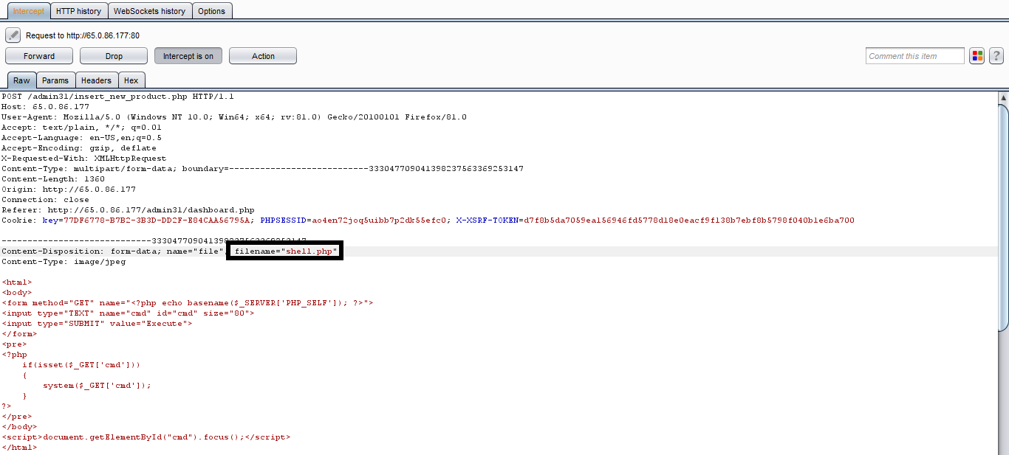
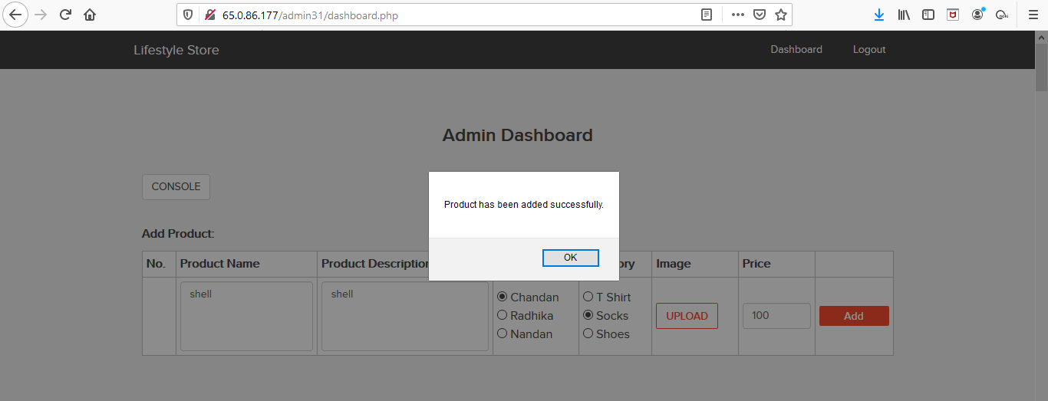
Observations :
By intercepting the request with burp suite we can change the extension from .jpg to .php

Slide 25
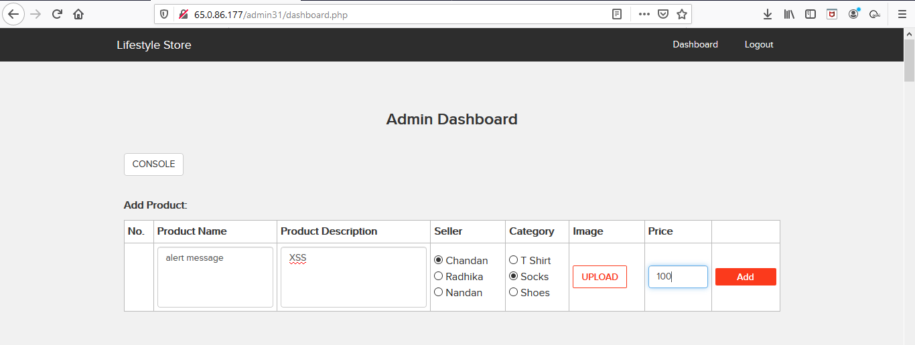
Observations
As we know there is no server side filter therefore by the same process we can also execute XSS.

Slide 26
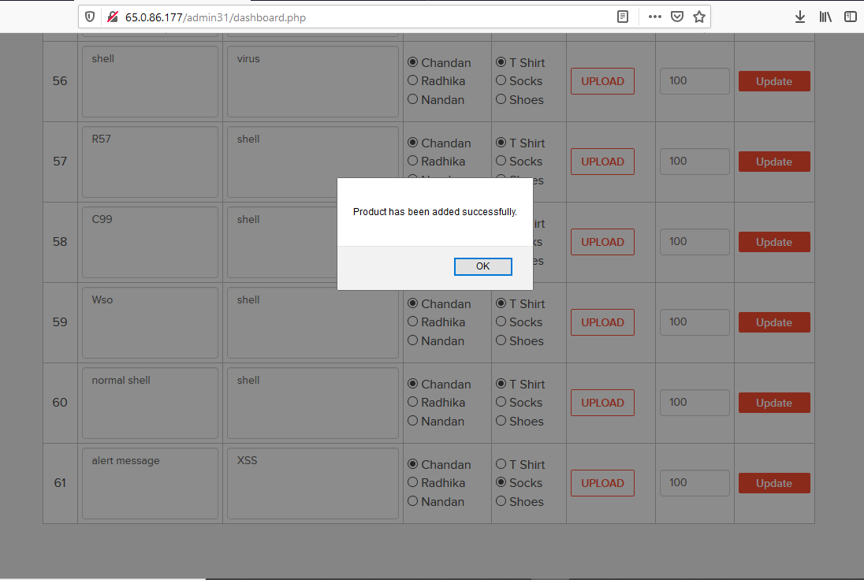
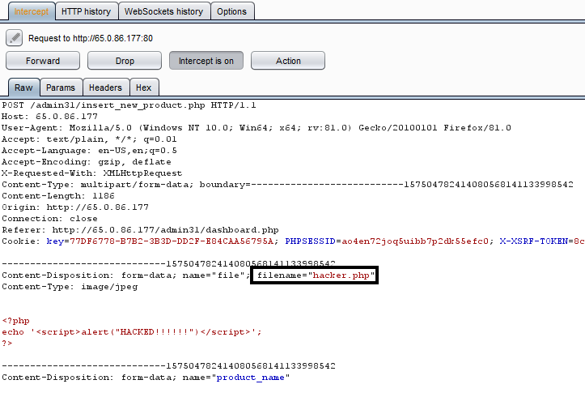
Observations

Slide 27
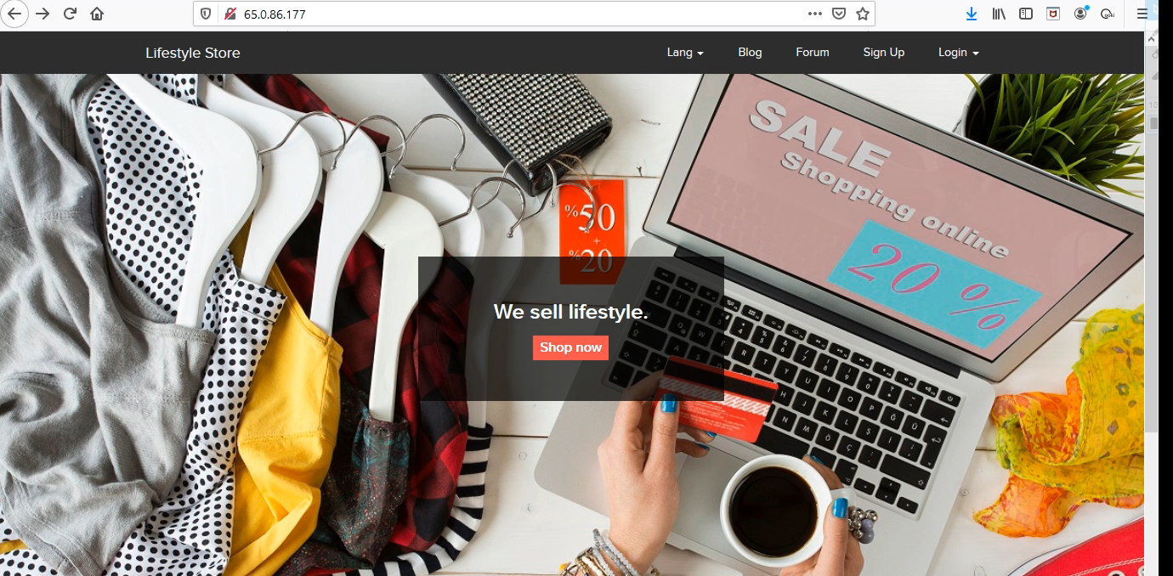
POC
As you can see in the video ; Shells have been successfully uploaded and they are working.

Slide 28
Business Impact – Extremely High
As the attacker can upload shells which will allow him to create a backdoor to the website and also to takeover the server ; he can steel user’s data and defame the name of the company.
Recommendations :
Have both server and client side filters for file upload.
No need of console panel on admin dash board.
References:
https://www.owasp.org/index.php/Cross-site_Scripting_(XSS)
https://en.wikipedia.org/wiki/Cross-site_scripting
https://www.ag-grid.com/javascript-grid-server-side-model/

Slide 29
4. Unauthorized access to customer details
Unauthorized access to customer details (critical) | The my order section of the website suffers from an insecure direct object reference (IDOR) , that allows hackers to get access to any other customer order details and more. Affected URL - http://13.127.6.41/orders/orders.php?customer=16 Affected parameter – Customer No. (Get)

Slide 30
Unauthorized access to customer details
Unauthorized access to customer details (critical) | Similar issues (IDOR) on these URL also. Affected URL - http://13.127.6.41/products/details.php?p_id=5 Affected Parameters – P_ID (GET) Affected URL - http://3.6.93.248/cart/cart.php Affected Parameters – P_ID (GET)

Slide 31
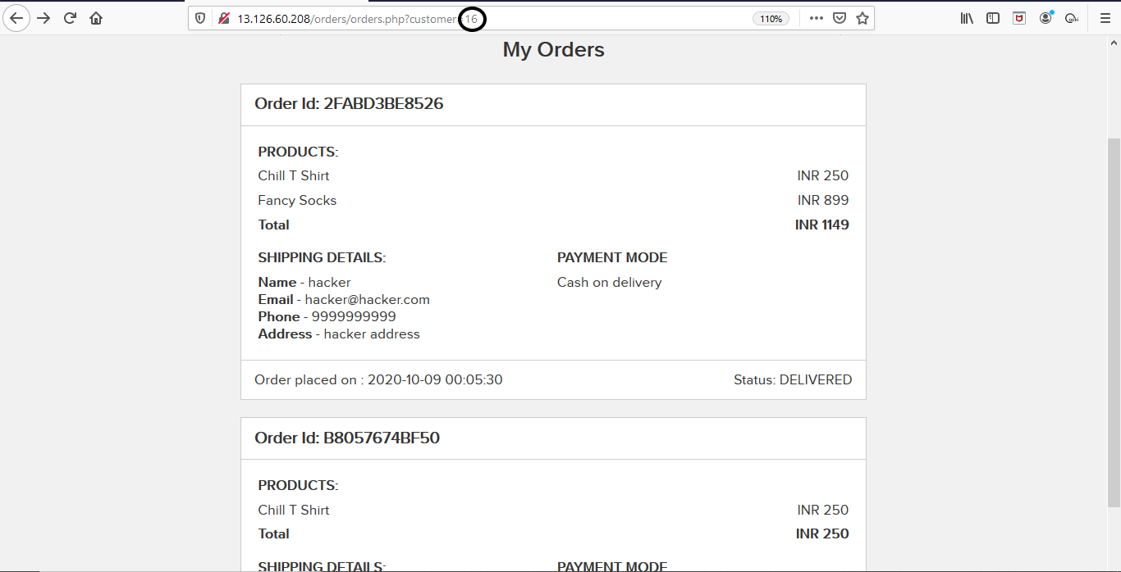
Observations
Login to your account and go to “My orders” section , you will see a get parameter as shown below , “customer=16”

Slide 32
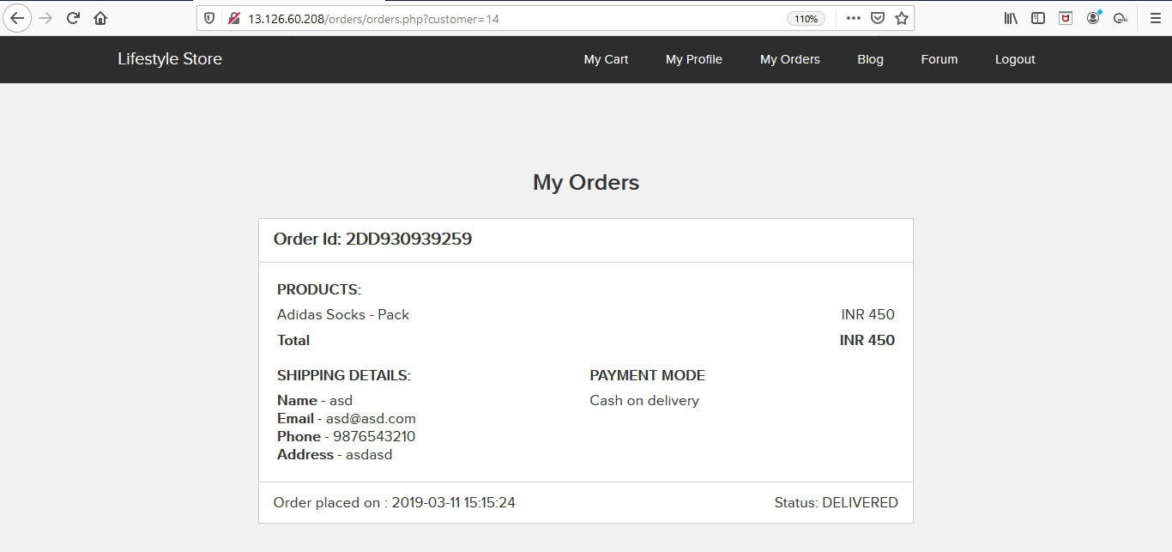
Observations
Change the customer number to any other random number and you will see that customer’s order details. In this case we changed it to 14.

Slide 33
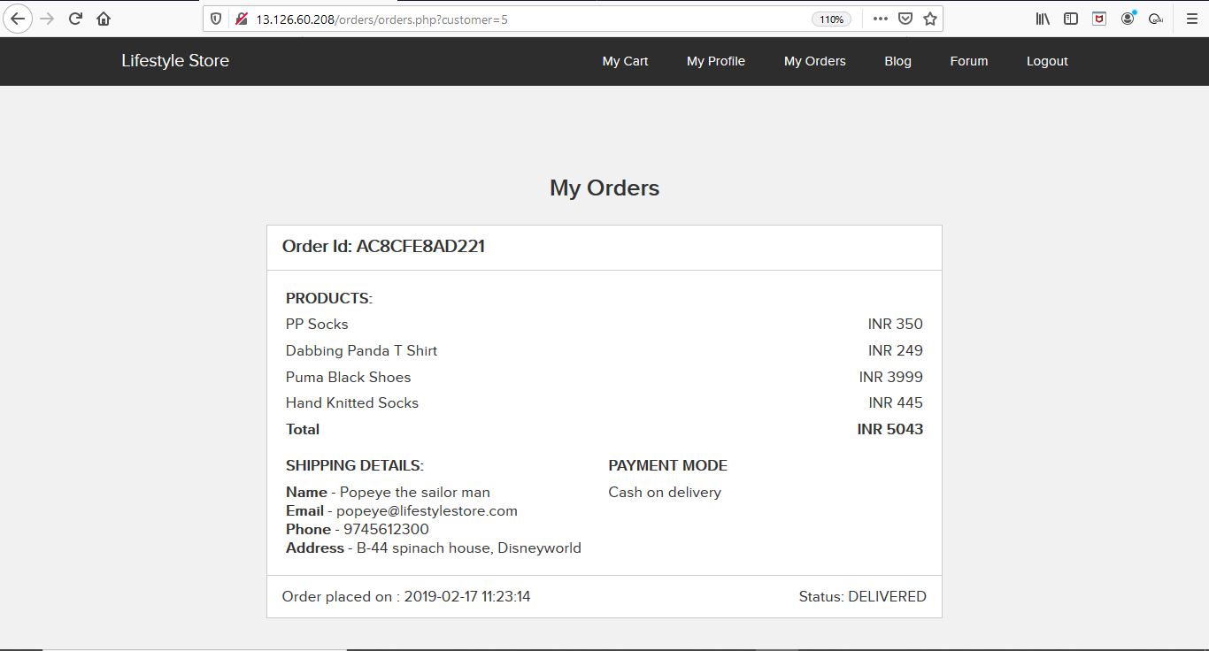
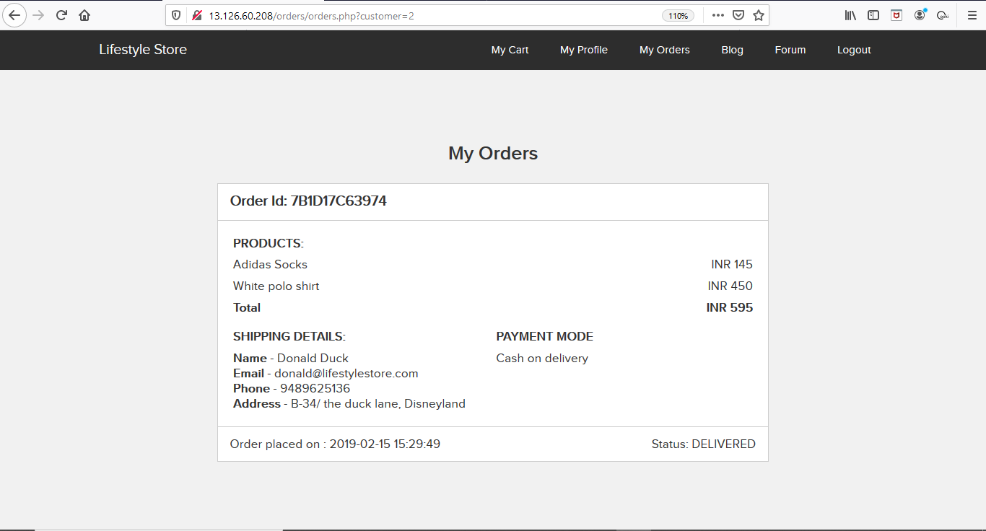
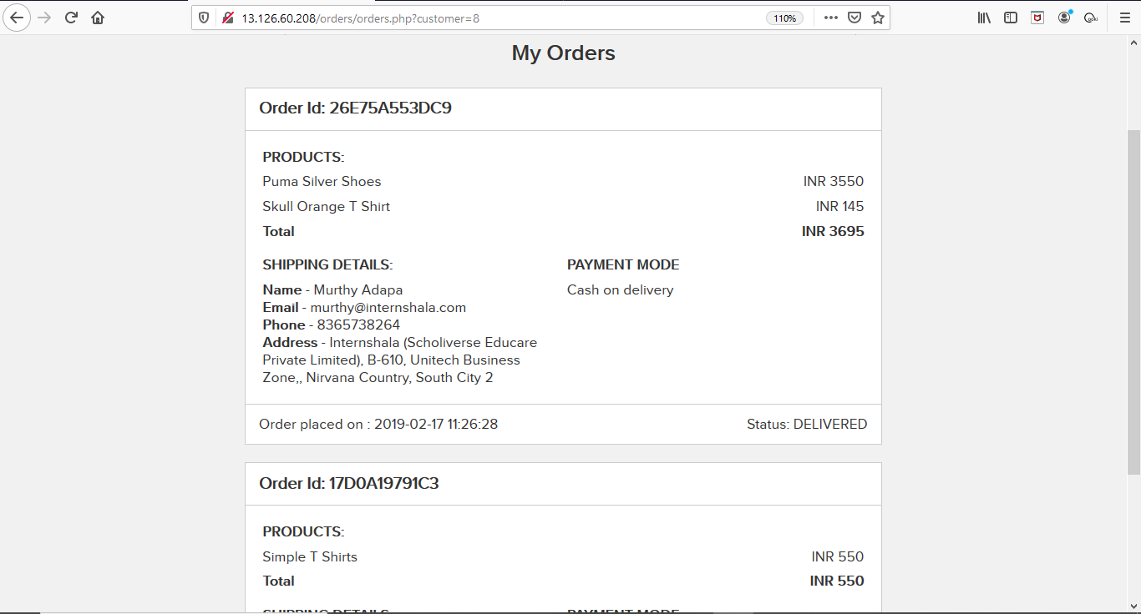
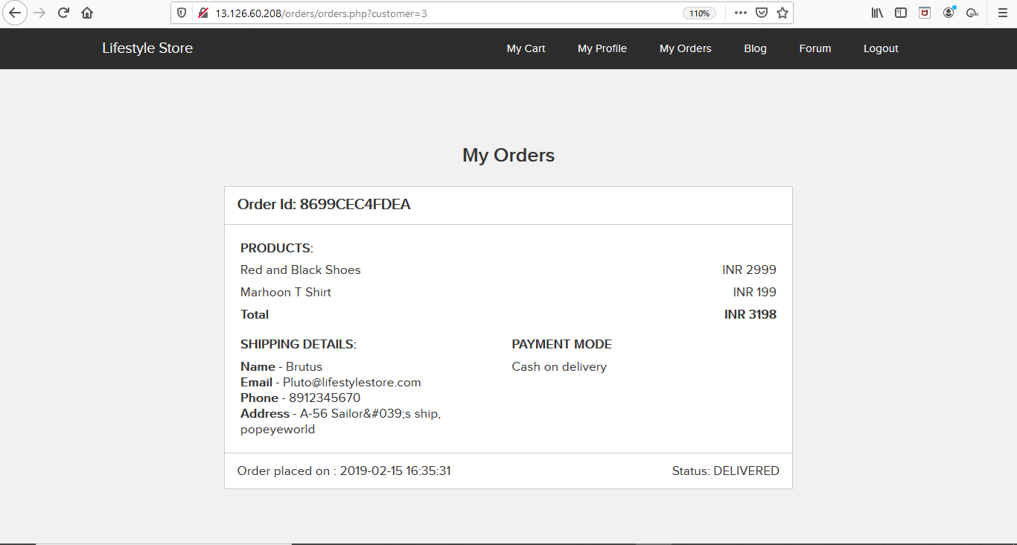
Observations

Slide 34
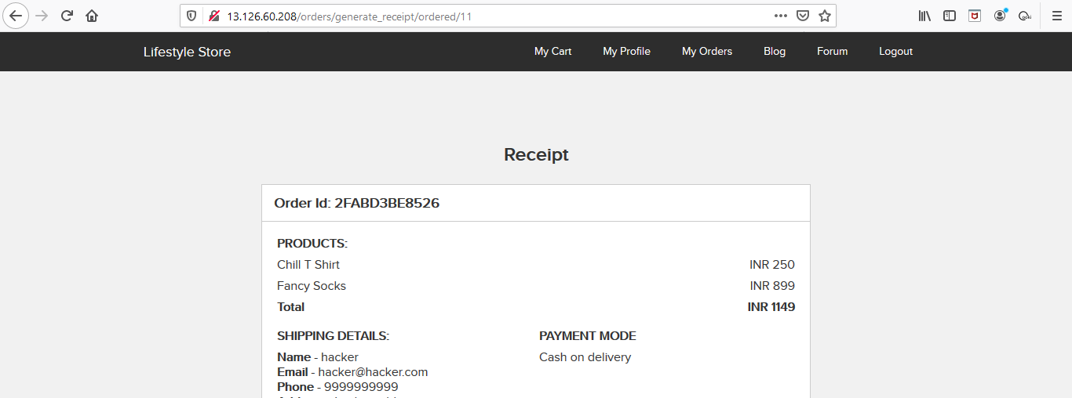
Observations
Login to your account and buy any product . After you buy any product a receipt will be generated which will have a url like this http://3.6.93.248/orders/generate_receipt/ordered/11 . If you replace the last number with some other random number then the receipt of some other customer will be displayed. This vulnerability can be brute forced to extract information of all the customers.

Slide 35
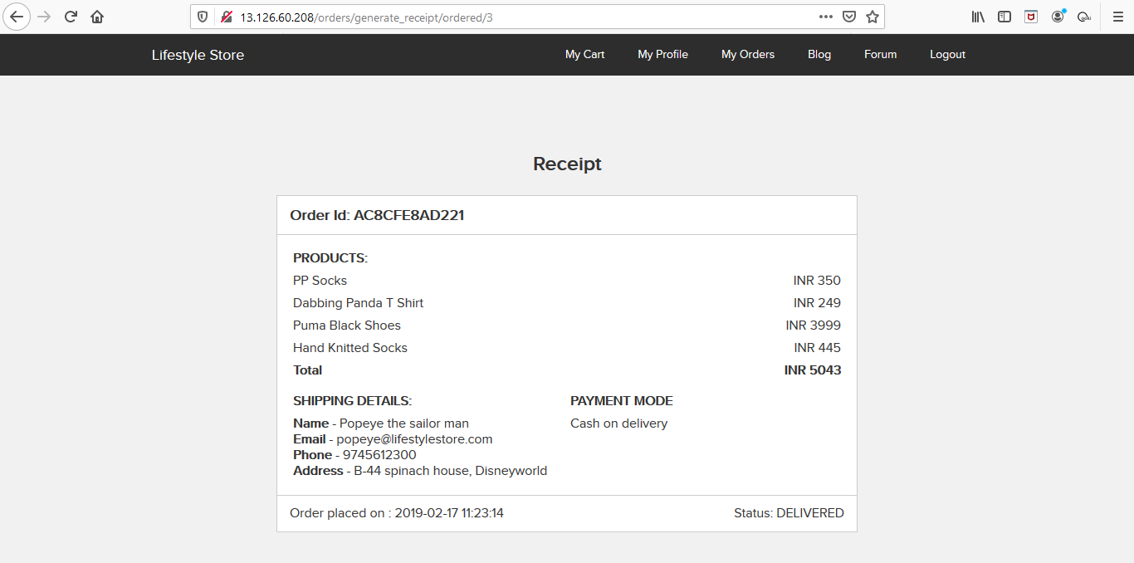
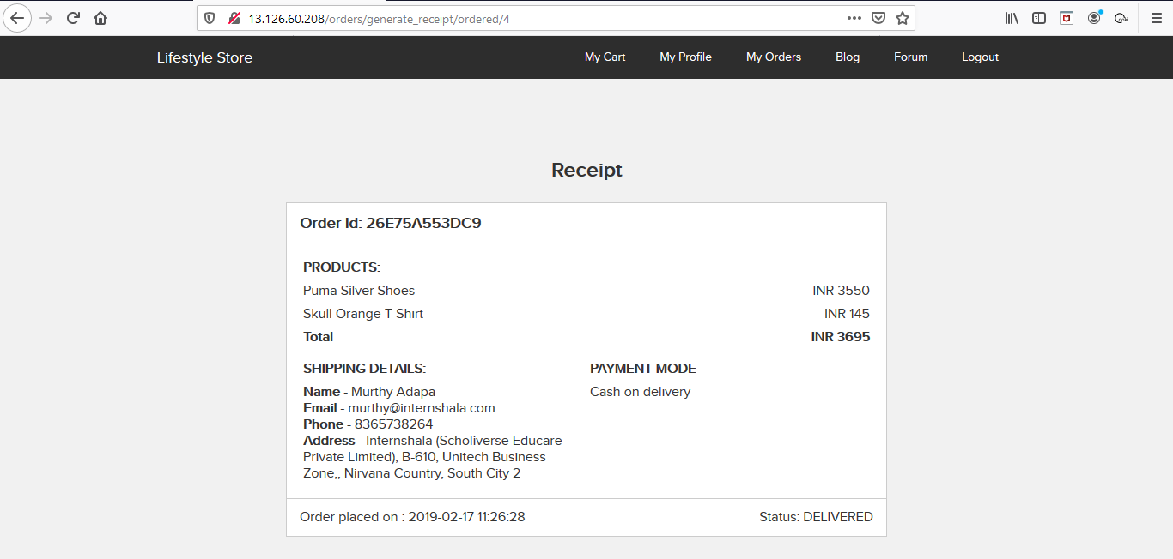
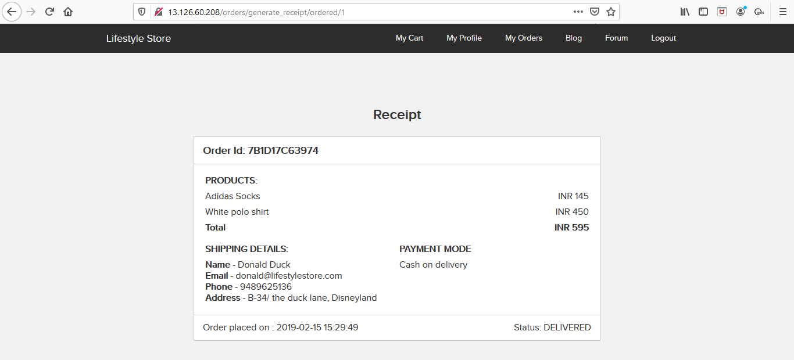
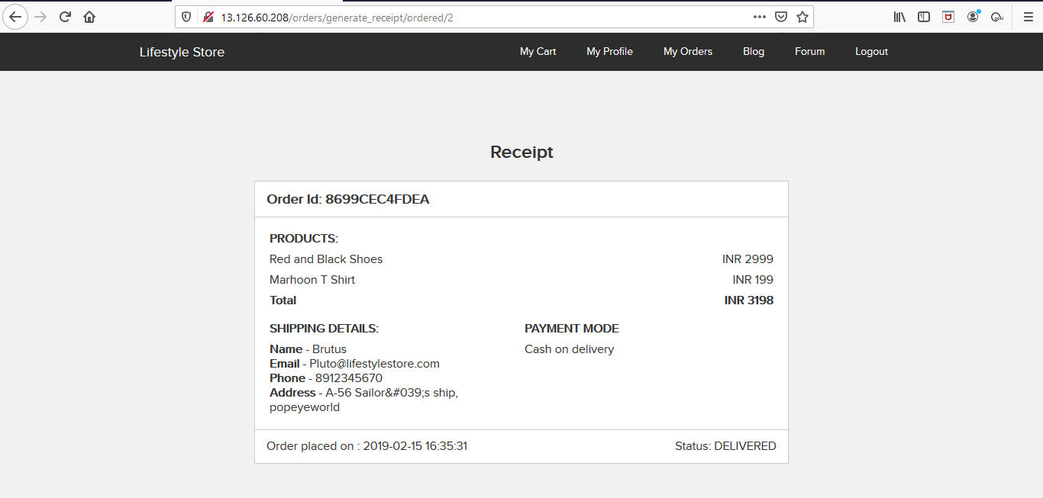
POC
Receipts extracted using brute forcing the url using burp suite.

Slide 36
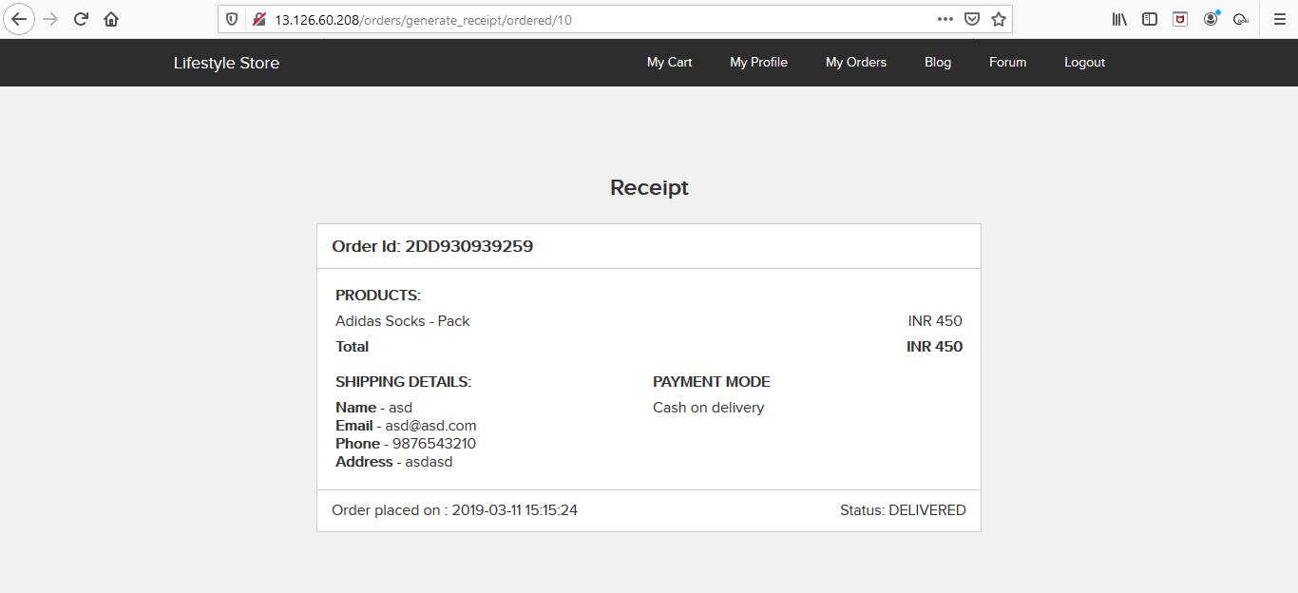
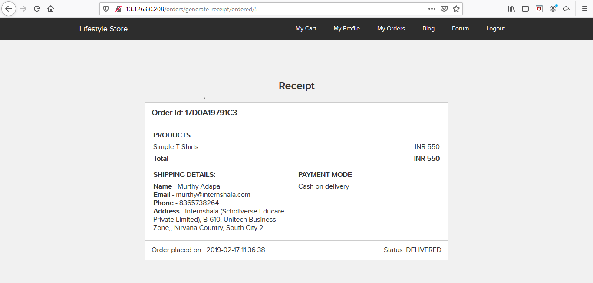
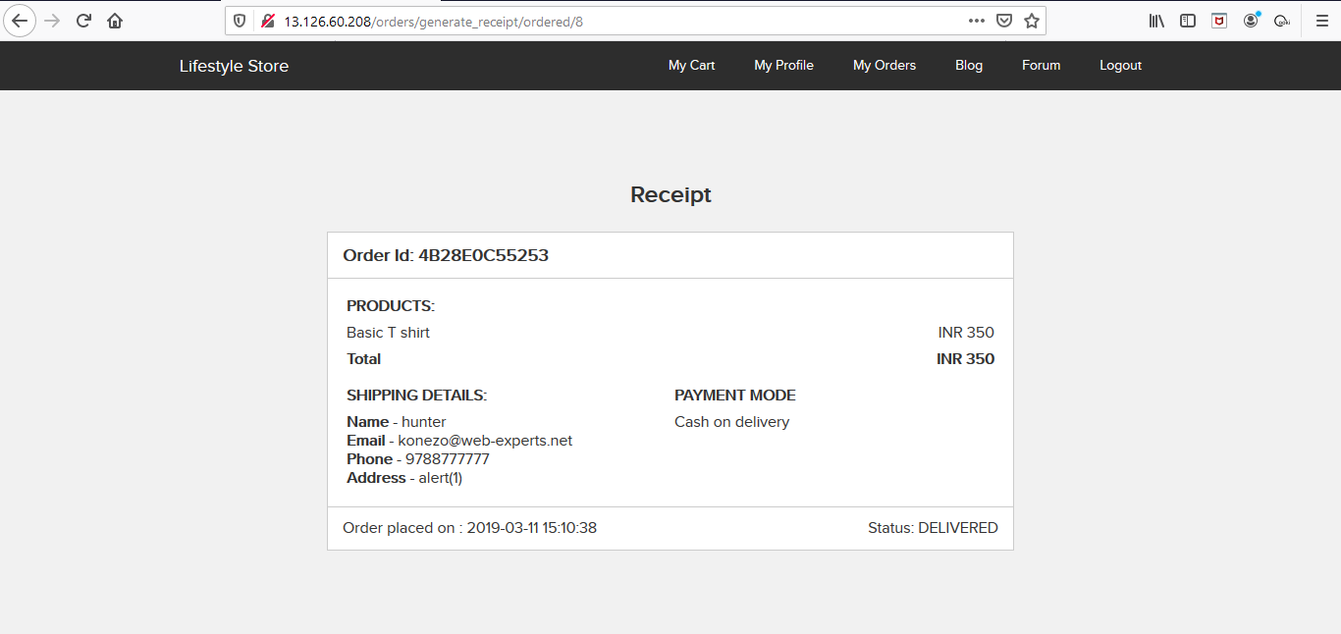
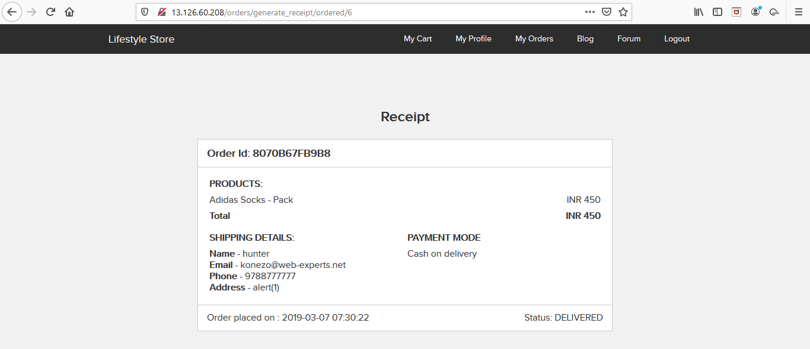
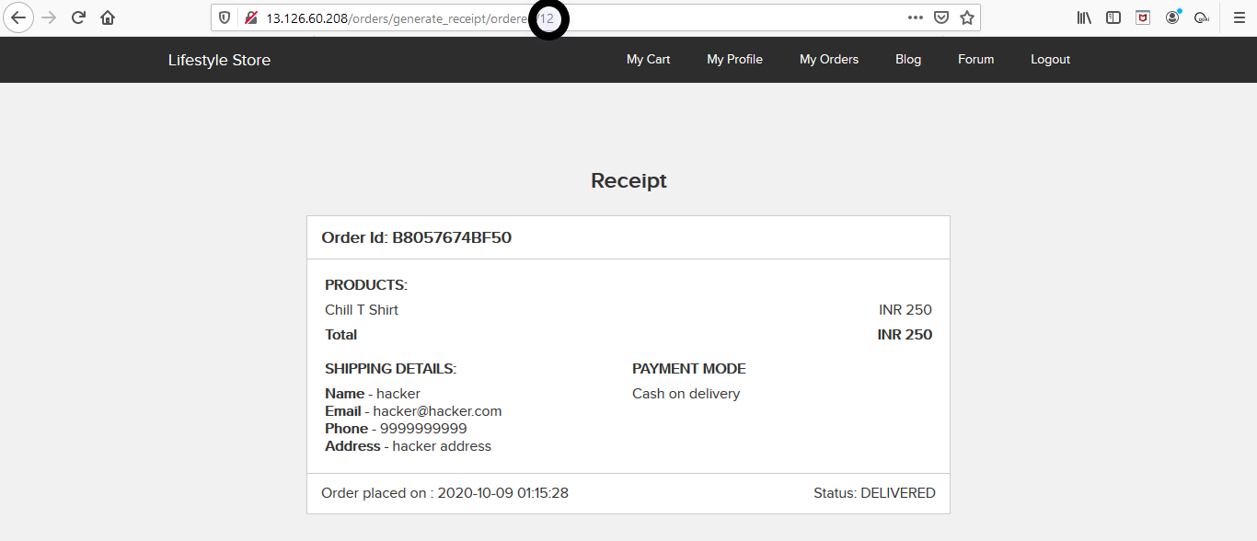
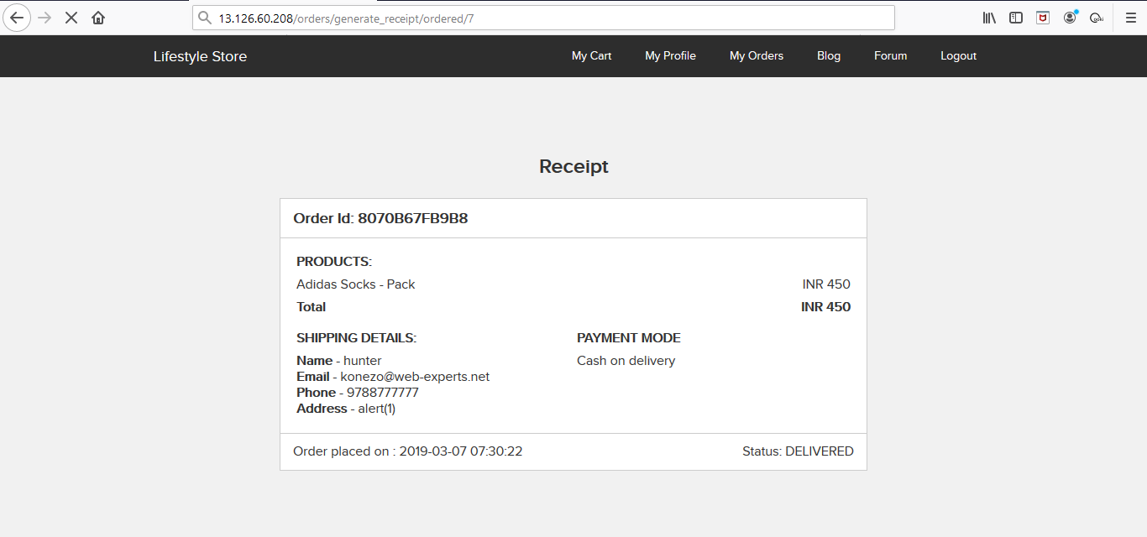

Slide 37
Business Impact - Extremely High
A malicious hacker can read bill information of any user just by knowing the Customer ID. This discloses critical billing information of users including:
Mobile Number
Email Id
Address
Order id
Billing Period
Bill Amount and Breakdown
This can be used by malicious hackers to carry out targeted phishing attacks on the users and the information can also be sold to competitors/blackmarket.
More over, as there is no rate limiting checks, attacker can bruteforce the user_id for all possible values and get bill information of each and every user of the organization resulting is a massive information leakage.

Slide 38
Recommendation:
Implement proper authentication and authorisation checks to make sure that the user has permission to the data he/she is requesting
Use proper rate limiting checks on the number of request comes from a single user in a small amount of time
Make sure each user can only see his/her data only.
References:
https://www.owasp.org/index.php/Insecure_Configuration_Management
https://www.owasp.org/index.php/Top_10_2013-A4-Insecure_Direct_Object_References

Slide 39
5. CSRF
CSRF (critical) | Below mentioned login page allows you to change password without verification and view details of other customers (CSRF): Affected URL: http://3.6.93.248/profile/change_password.php Affected URL: http://3.6.93.248/forum/index.php?u=/user/profile/5/edit Affected Parameter: Update Button (POST REQUEST)

Slide 40
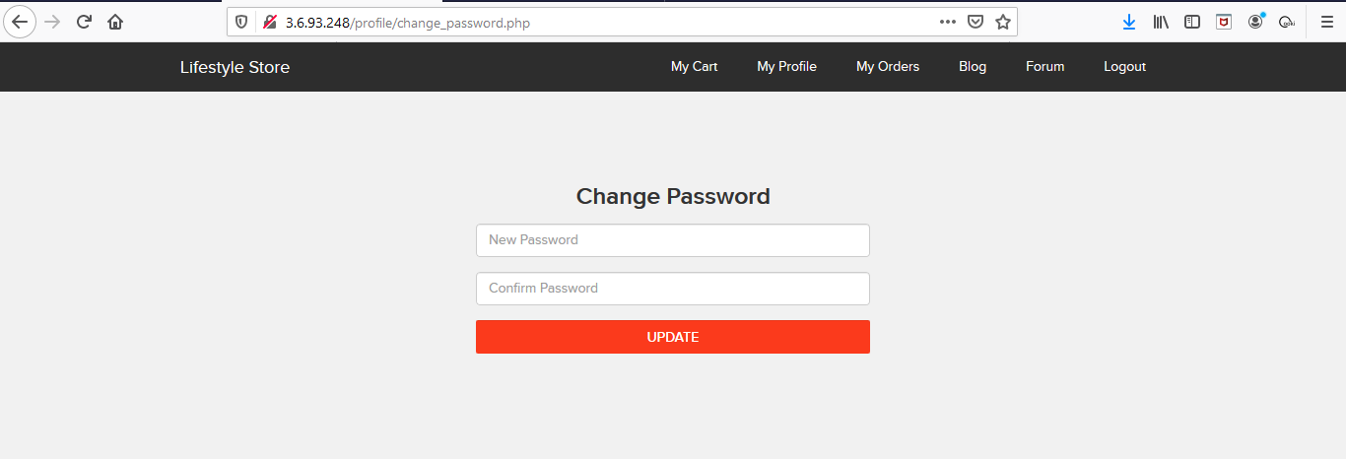
Observations
Log into your account and go to change password. Here we will change the password and intercept the request using burp suite. As the password is not encrypted we will be able to make changes in it.

Slide 41
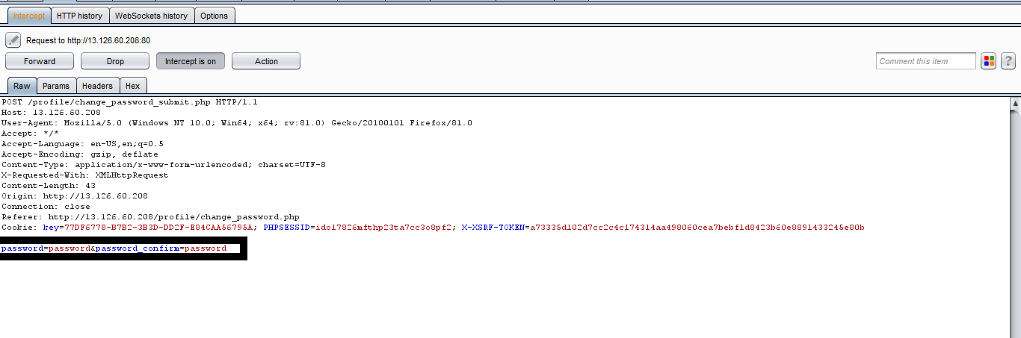
POC
Request intercepted and password changed.

Slide 42
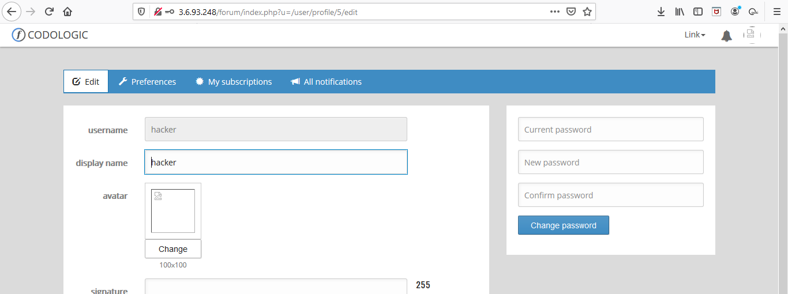
Observation
Click on Forum. Login to your account. Go to Edit. On the right hand side their will be an option to change password. Here also the password fields are not encrypted therefore we can intercept the request and make changes to the password.

Slide 43
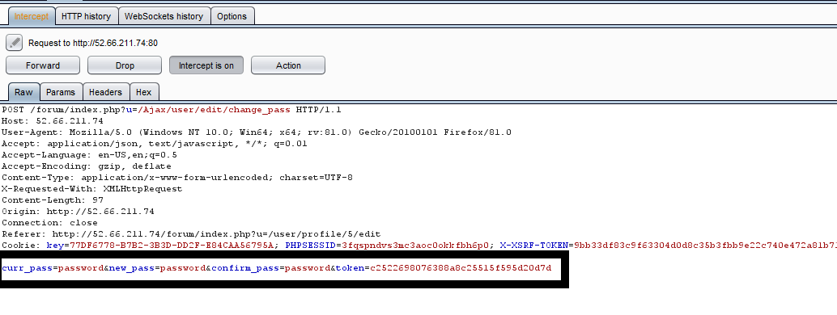
POC
Request intercepted and password changed.

Slide 44
Business Impact – Very High
Hacker can change the password of any user.
Hackers can change orders of the victim’s account.
It can make a very bad impact of the web site in front of the users.

Slide 45
Recommendations
Implement an anti-csrf token.
Check the source of the request made.
Encrypt the password while sending it as a request.
Use two factor confirmation like OTP.
References
https://owasp.org/www-community/Anti_CRSF_Tokens_ASP-NET

Slide 46
6. Brute Forcing Coupon Code
Brute Forcing Coupon Code (severe) | Below mentioned url can be attacked using brute force. Affected URL: http://3.6.93.248/cart/cart.php Affected Parameter: Coupon code box

Slide 47
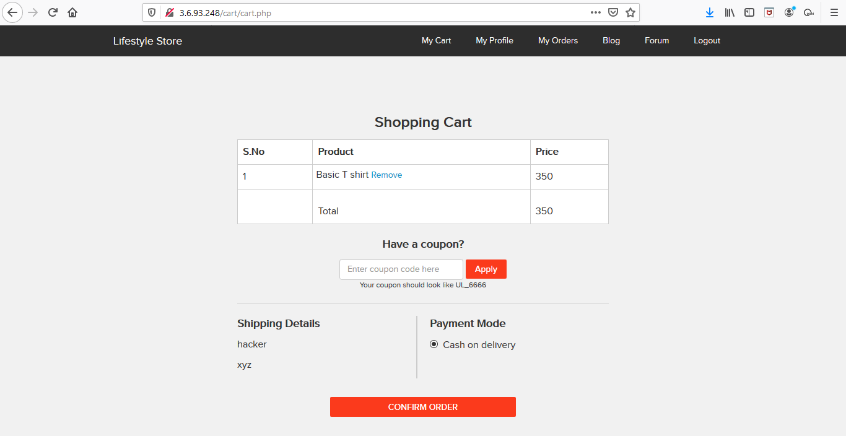
Observation
Log into your account and add any product to your cart. Then go to my cart. In the center of the page their will be a box saying “Enter coupon code here”. Here we can brute force the coupon code using the hint below.

Slide 48
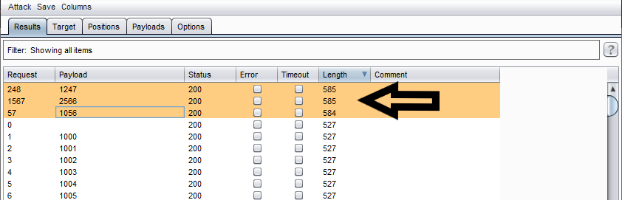
POC
Coupons found using brute forcing.

Slide 49
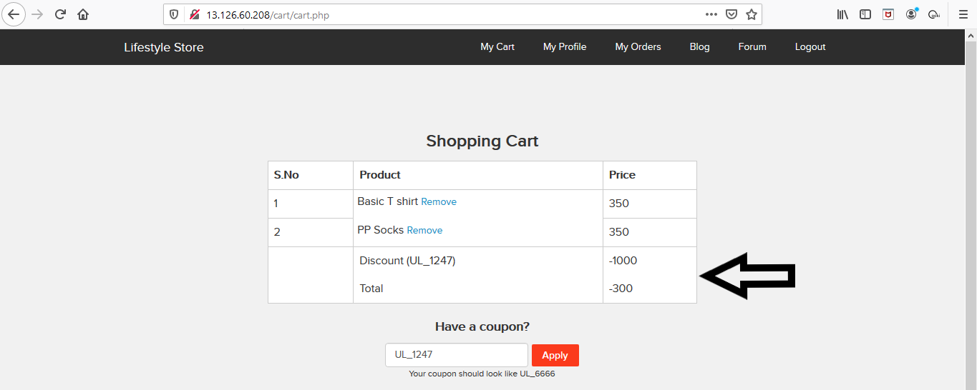
POC
Coupon applied

Slide 50
Business Impact - High
Using this vulnerability malicious hackers can cause high financial loss to the company.
Recommendations
Remove the hint below the coupon box.
Apply rate limiting filters

Slide 51
7. Reflected cross-site-scripting (XSS)
Reflected cross-site-scripting (XSS) (Severe) | Below mentioned url are affected by XSS. Affected URL: http://13.233.124.222/products/details.php?p_id=2 Affected Parameter: Url box (any thing after p_id) Payload: <script>alert(1)</script> Affected URL: http://13.233.124.222/products/details.php?p_id=2 Affected Parameter: comment box Payload: <script>alert(1)</script>

Slide 52
Reflected cross-site-scripting (XSS)
Reflected cross-site-scripting (XSS) (Severe) | Affected URL: http://13.233.124.222/products/details.php?p_id=2 Affected Parameter: Search Box Payload: <script>alert(1)</script> Affected URL: http://3.6.93.248/profile/16/edit/ Affected Parameter: Address (POST Parameter) Payload: <script>alert(‘1’)</script>

Slide 53
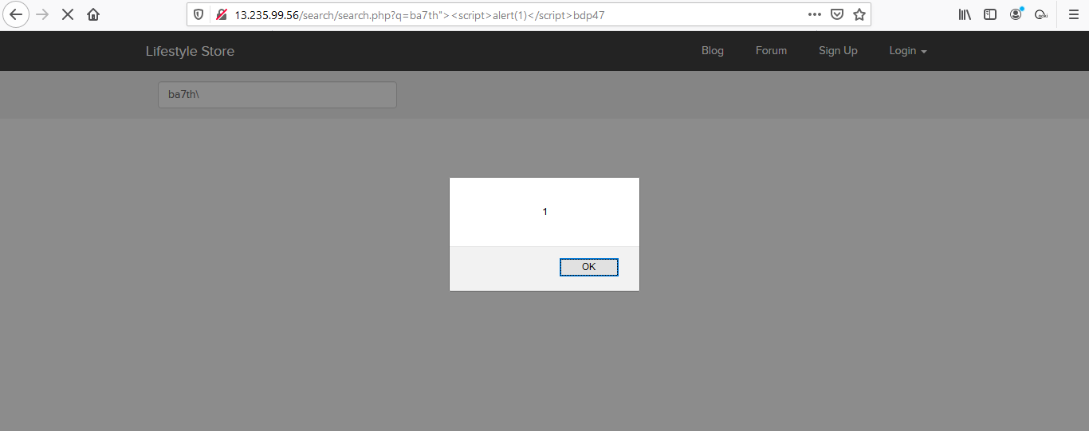
Observations
Go to the main page and click on shop now. You will be redirected to products page. Here on top left corner there is a search box which is vulnerable to xss. Type the following payload in it and press enter :
ba7th’> <script>alert(1)</script>bdap47

Slide 54
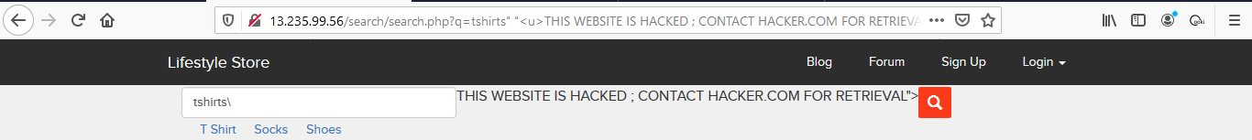
Observations
It can also be used to deface the web page by typing the following payload in the search box : tshirts\ “ “<u>hacked</u>

Slide 55
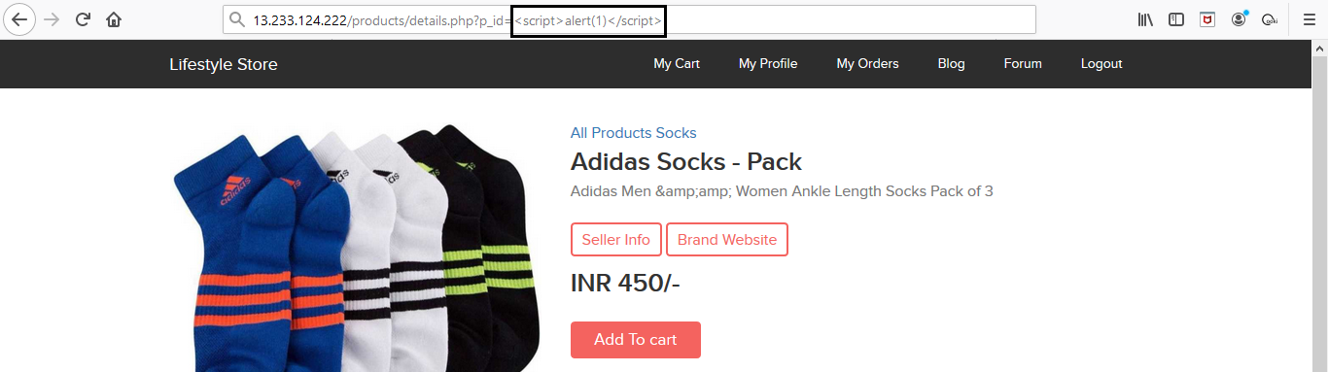
Observations :
Login to your account and navigate to the products section and select any product 2 . The url shows the id of that product replace that with <script>alert(1)</script> .

Slide 56
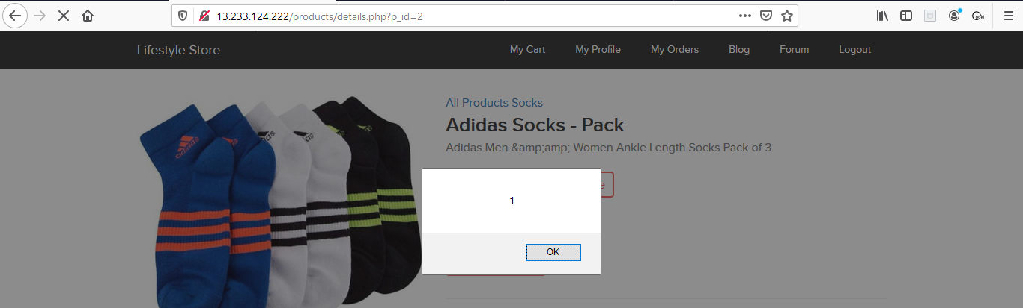
Observations :
After entering the payload press enter. It will redirect you to the home page but if you go back to that same product you will see an alert box ; which confirms the vulnerability.

Slide 57
POC
In comment section XSS is also present. Select any product and type the following payload in the comment box:
<script>alert(1)</script>

Slide 58
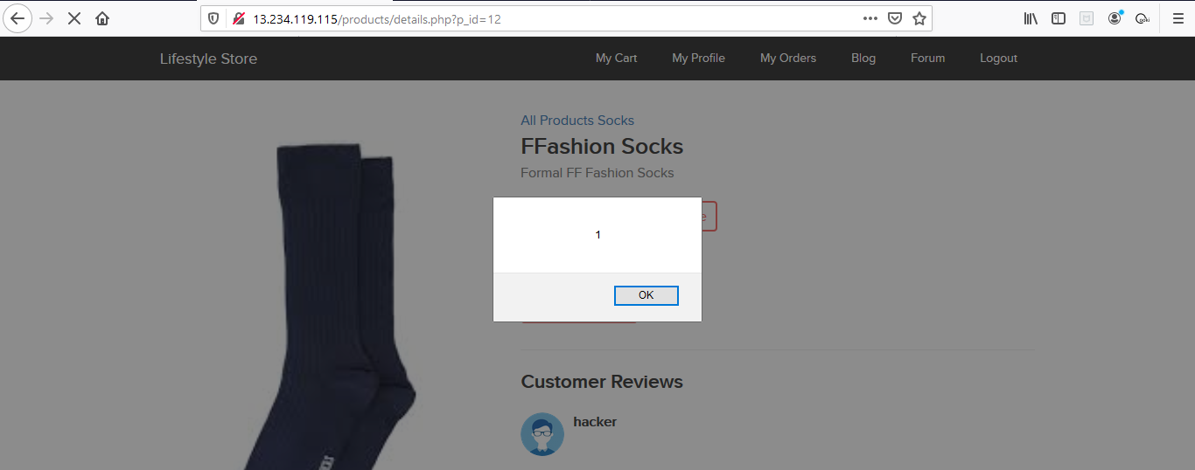
POC
The alert box which appears after posting the comment confirms the vulnerability.

Slide 59
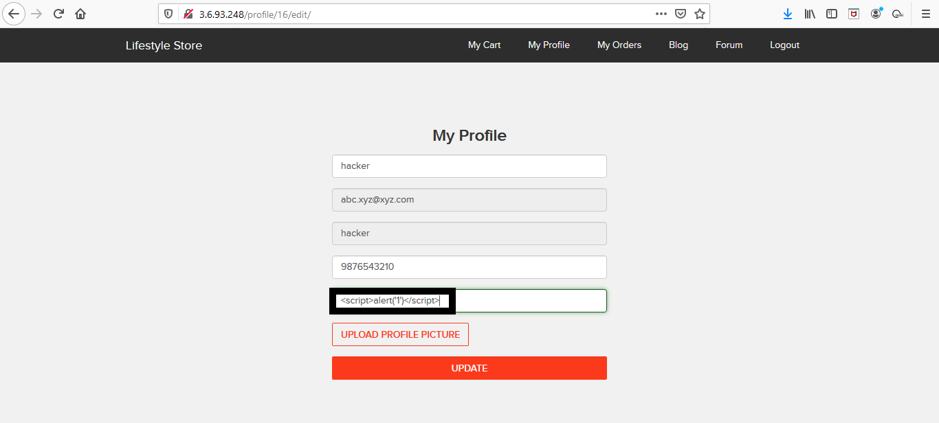
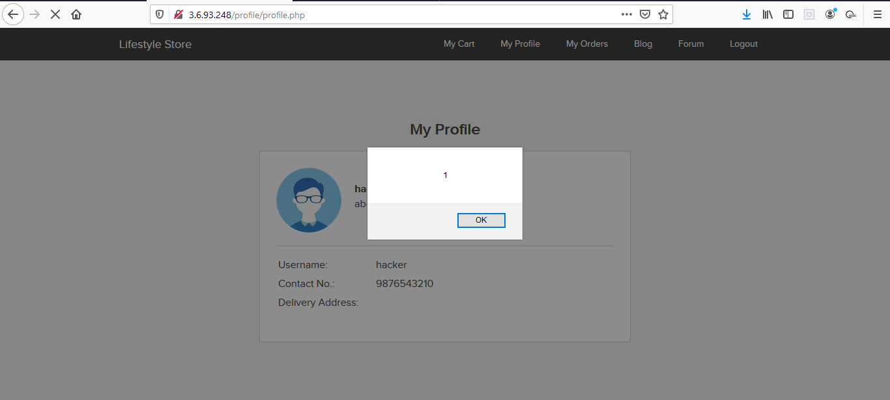
POC
Log into your account and go to Edit Profile. Type the following payload in address block: <script>alert(‘1’)</script>
Now go back to My profile and you will see the alert message which will confirm the vulnerability.

Slide 60
Business Impact - High
As attacker can inject arbitrary HTML CSS and JS via the URL, attacker can put any content on the page like phishing pages, install malware on victim’s device and even host explicit content that could compromise the reputation of the organization
All attacker needs to do is send the link with the payload to the victim and victim would see hacker controlled content on the website. As the user trusts the website, he/she will trust the content.

Slide 61
Recommendations
Take the following precautions:
Sanitize all user input and block characters you do not want
Convert special HTML characters like ‘ “ < > into HTML entities &quot; %22 &lt; &gt; before printing them on the website
References:
https://www.owasp.org/index.php/Cross-site_Scripting_(XSS)
https://en.wikipedia.org/wiki/Cross-site_scripting
https://www.w3schools.com/html/html_entities.asp

Slide 62
8. Directory Listings
Directory Listings (Severe) | Below mentioned urls are affected by XSS : http://13.234.119.115/robots.txt http://3.6.93.248/phpinfo.php 3.6.93.248/composer.lock http://3.6.93.248/composer.json

Slide 63
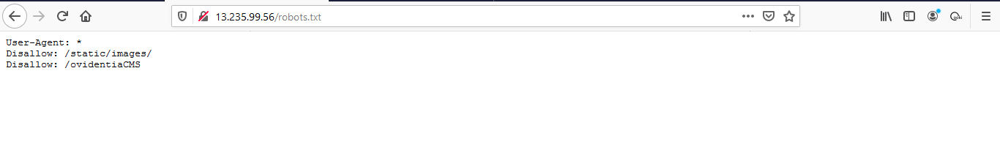
Observations
Go to http://13.234.119.115/robots.txt .
robots.txt file will open.
Image of the customer , images of the products , all the product page info and the administrator directory will be visible.
ovidentiaCMS also suffers from weak password ; which lets the attacker get inside the administrator panel without much trying.

Slide 64
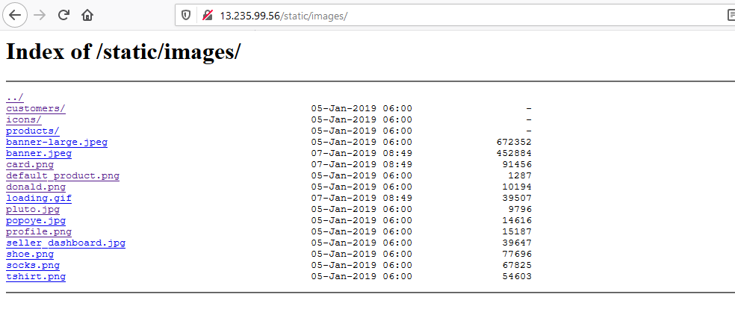
POC

Slide 65
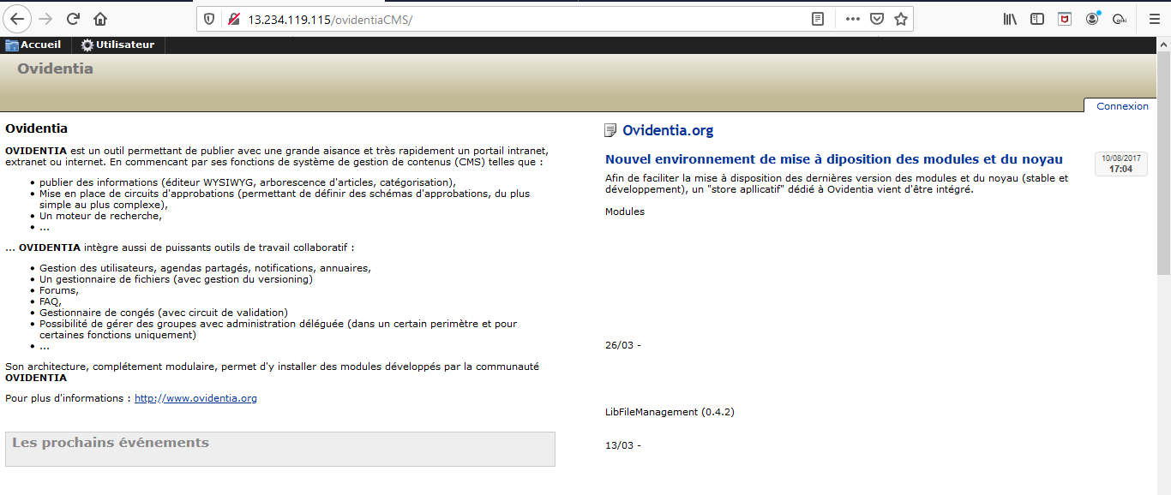
POC
ovedentiaCMS main page

Slide 66
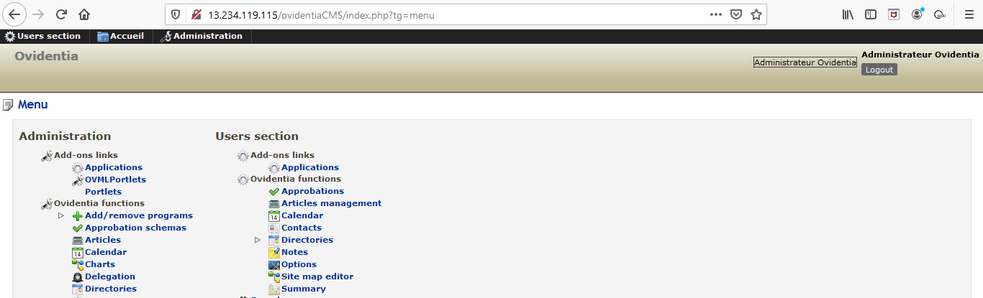
POC
Logged into ovedentiaCMS using default Login id and password i.e. admin@admin.bab and 012345678 .
Also changed Language to English

Slide 67

POC
Entered Administrator panel

Slide 68


POC – composer.lock , composer.json

Slide 69

POC
Userlist.txt - Shows some accounts of sellers

Slide 70

POC

Slide 71
Business Impact - High
A hacker can get all the information of the CMS and also get access to administrator Log ins thus compromising the name of the company.
A malicious hacker can take important information from seller point of view and what products every seller is selling and at what price.

Slide 72
Recommendations
Disable Directory Listing
Put an index.html in all folders with default message
Remove all the default passwords and usernames and put your own strong password made of at least 8 alpha – numeric characters.
References:
https://cwe.mitre.org/data/definitions/548.html
https://www.netsparker.com/blog/web-security/disable-directory-listing-web-servers/

Slide 73
9. Information Disclosure
Information Disclosure (Low) | Below mentioned url are affected by XSS : Affected URL - http://13.234.119.115/server-status/ Below mentioned url disclose seller information due to development flaw: Affected url - http://3.6.93.248/products/details.php?p_id=11

Slide 74

Observations
Go to http://3.6.93.248/products.php and select any product. Click on seller information. It will display seller email id and other personal information.

Slide 75
Observations
Go to http://13.234.119.115/server-status/
It will open the apache server page which displays all the server related information.

Slide 76

POC

Slide 77
Business Impact – Moderate
Although this vulnerability does not have a direct impact to users or the server, though it can help the attacker in mapping the server architecture and plan further attacks on the server
Recommendation
Take the following precautions:
Disable all default pages and folders including server-status and server-info
References:
https://vuldb.com/?id.88482
https://httpd.apache.org/docs/current/mod/mod_status.html
https://www.beyondsecurity.com/scan_pentest_network_vulnerabilities_apache_http_server_httponly_cookie_information_disclosure

Slide 78
10. Default Messages
Default Messages (low) | In the Below mentioned url if you add a specific payload it will display a default message Affected URL: http://3.6.93.248/?includelang=lang/en.php Affected Parameter: en.php (GET parameter)

Slide 79

Observations and POC
In the url http://3.6.93.248/?includelang=lang/en.php ; if we add a comma after en.php we get an error message.

Slide 80
Business Impact - Moderate
Although this vulnerability does not have a direct impact on the client or the server ; it can help the attacker in mapping the server architecture and planning further attacks.
Recommendations :
Do not display default errors because it also tells about the location.
References:
https://owasp.org/www-community/Improper_Error_Handling

Slide 81
11. Open Redirection
Default Messages (low) | In the Below mentioned urls we can change the path of redirection Affected URL: http://3.6.93.248/?includelang=lang/en.php http://3.6.93.248/?includelang=lang/fr.php Affected Parameter: http://3.6.93.248/?includelang=http://www.google.com?lang/en.php

Slide 82

Observations
Here we made changes to the url according to the payload in burp suit.

Slide 83

POC
We are redirected to google.

Slide 84
Business Impact - Low
An hacker can redirect the request to a malicious site. This can cause harm to the client and he can loose his trust in the website.
Recommendations :
Disable Offsite Redirects.
An id should be used to redirect the user.
A redirection page should be used on which the user have to confirm redirection.
References:
https://cwe.mitre.org:443

Slide 85
12. PII Leakage
PII Leakage (Critical) | Below mentioned url leaks critical information via PII leakage. Affected URL: http://13.234.119.115/static/images/uploads/ Affected Parameter: images

Slide 86
Observations
Open http://13.234.119.115/products.php , now drag any product’s image to a new tab.
Now remove the name of the image and press enter.
The product images folder will open.

Slide 87

POC

Slide 88
Business Impact - High
A malicious hacker can gain access to shell applications and various other HTML files which have been shown in the listing. Also it have a week password flaw as well.
A hacker can get access to the shell through which he can upload his own malicious code and cause damage to the website.

Slide 89
Recommendations:
2 factor authentication should be added for sensitive data with a strong password.
Find all PII stored and encrypt them with encryption technique.
Disable the listing.

Slide 90
13. Self Redirection / HTML /Brute Forcing / Developer Flaw
Brute Forcing/HTML / Developer Flaw (Low) | Below mentioned url has a development flaw as it displays the customer email id. Affected URL - http://13.234.119.115/reset_password/customer.php Affected parameter – Password reset

Slide 91
Observations
Go to http://13.234.119.115/login/customer.php .
Copy any user name.
Click on “Forgot your password?”
Paste the copied username in the username section.
It will display the email id of the user.
It can also be brute forced using Burp Suite for extracting customer’s email id.

Slide 92



POC

Slide 93


POC
Customer’ s Usernames brute forced using burp suite.

Slide 94
Business Impact - Low
Hacker can only find out the email id of the user but he can still carry out phishing attacks or brute force the password due to rate limiting flaw.

Slide 95
Recommendation
Do not display the email id on the screen ; directly send the link to the email id.
Better authentication should be provided and re-direction site must be rechecked before in action.
References:
https://swoopnow.com/website-authentication/#4

Slide 96
14. Multiple Vulnerabilities found in blog sites (PII leakage , temporary XSS , etc)
Multiple Vulnerabilities in blog sites (PII leakage , temporary XSS , etc) (critical) | Below are the affected URL and parameters of the blog site : Affected URL - http://3.6.93.248/wondercms/ Affected URL - http://3.6.93.248/wondercms/files/b374kmini.php Affected Parameter - File Upload (Post) Affected URL - http://3.6.93.248/wondercms/home Affected Parameter - File (Get)

Slide 97

Observations
On the front page of the website we can find the login option , that says “Click here to log in , the password is admin” . By clicking on it ; it will redirect us on the login page where we just have to type ‘admin’ as password and we will log into the admin account. This is server side misconfiguration.

Slide 98

Observations:
When we log in as admin , we see some text which says ‘It’s alive !’ . When we click on it ; We can see the source code of the website. A malicious hacker can easily use this for phishing attacks.

Slide 99


Observations
After logging into the site as Admin ; go to settings then go to files. Here you can see some files with ‘.php’ extension. These files can give you information about the site and some of them are also capable of taking over the site. Here if we select ‘/wondercms/files/b374kmini.php’ it will open the b374mini shell which is used by hackers as backdoor into the website. It will give us many crucial information such as server ip address , database , shell , php info , upload files and one can also mail some one which can be used for phishing attacks.

Slide 100

Observations
From this page the attacker can know all about the backend technology used.

Slide 101

Observations
When we are in the admin account and we got to settings -> general option. We can see that an attacker can inject and execute malicious client side scripts which can get permanently stored in the database.

Slide 102
Observations
When we are in the admin account and we got to settings -> files option. We see that files can be uploaded with any kind of file extension. An attacker can upload shells through which he can takeover the site whenever he wants.

Slide 103
Business Impact – Extremely High
The blog site has multiple vulnerabilities such as Temporary and permanent XSS , server side errors and development flaws. Therefore this site is extremely vulnerable as the attacker can take complete control of the site and can target the users by using all the vulnerabilities of this web site. This will lead to defamation of the company name and the customers will lose their trust in this website.

Slide 104
Recommendations :
Web site should have 2 way authentication.
Develop the backend more secure.
Remove all directory listings and add proper sanitization techniques at checks of the website.
Check the file extension both at the client side and server side for file uploading
References :
https://cwe.mitre.org/data/definitions/548.html
https://www.w3schools.com/

Slide 105
THANK YOU Contact to – divyansh.2109@gmail.com or 8429399383 for further details and patch assistance

